Slide 1
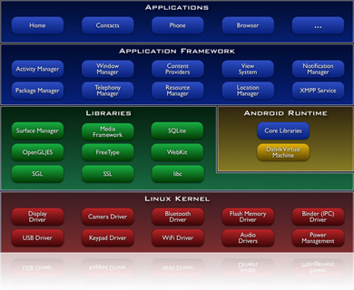
Application Framework
Part 2 Activating and Closing Components
Notes:
Android applications are written in the Java programming language. The compiled Java code — along with any data and resource files required by the application — is bundled by the aapt tool into an Android package, an archive file marked by an .apk suffix. This file is the vehicle for distributing the application and installing it on mobile devices; it's the file users download to their devices. All the code in a single .apk file is considered to be one application.
In many ways, each Android application lives in its own world:
By default, every application runs in its own Linux process. Android starts the process when any of the application's code needs to be executed, and shuts down the process when it's no longer needed and system resources are required by other applications.
Each process has its own Java virtual machine (VM), so application code runs in isolation from the code of all other applications.
By default, each application is assigned a unique Linux user ID. Permissions are set so that the application's files are visible only that user, only to the application itself — although there are ways to export them to other applications as well.
It's possible to arrange for two applications to share the same user ID, in which case they will be able to see each other's files. To conserve system resources, applications with the same ID can also arrange to run in the same Linux process, sharing the same VM.

Slide 2
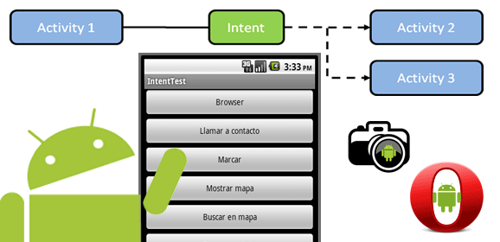
Activating components: intents
Content providers are activated when they're targeted by a request from a ContentResolver. The other three components — activities, services, and broadcast receivers — are activated by asynchronous messages called intents.
Notes:
An intent is an Intent object that holds the content of the message. For activities and services, it names the action being requested and specifies the URI of the data to act on, among other things. For example, it might convey a request for an activity to present an image to the user or let the user edit some text. For broadcast receivers, the Intent object names the action being announced. For example, it might announce to interested parties that the camera button has been pressed.

Slide 3
Intents Activation Methods
There are separate methods for activating each type of component:
An activity is launched
A service is started
An application can initiate a broadcast to other activities.

Slide 4
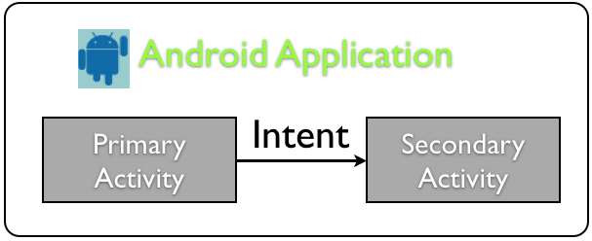
An activity is launched
By passing an Intent object to Context.startActivity() or Activity.startActivityForResult()
One activity often starts the next one:
  Intent intent = new Intent (this, SecondaryActivity.class);
  startActivity(intent);
Notes:
The responding activity can look at the initial intent that caused it to be launched by calling its getIntent() method. Android calls the activity's onNewIntent() method to pass it any subsequent intents.
One activity often starts the next one. If it expects a result back from the activity it's starting, it calls startActivityForResult() instead of startActivity(). For example, if it starts an activity that lets the user pick a photo, it might expect to be returned the chosen photo. The result is returned in an Intent object that's passed to the calling activity's onActivityResult() method.

Slide 5
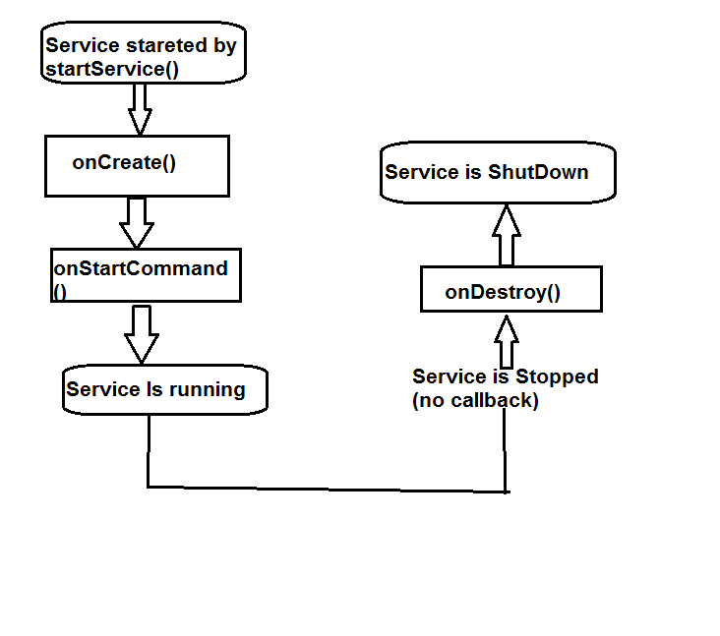
A service is started
By the passage of an Intent object to Context.startService(). Android calls the service's onStart() method and passes it the Intent object.
Notes:
Similarly, an intent can be passed to Context.bindService() to establish an ongoing connection between the calling component and a target service. The service receives the Intent object in an onBind() call. (If the service is not already running, bindService() can optionally start it.) For example, an activity might establish a connection with the music playback service mentioned earlier so that it can provide the user with the means (a user interface) for controlling the playback. The activity would call bindService() to set up that connection, and then call methods defined by the service to affect the playback.
A later section, Remote procedure calls, has more details about binding to a service.

Slide 6
An application can initiate a broadcast
by passing an Intent object to methods like Context.sendBroadcast(), Context.sendOrderedBroadcast(), and Context.sendStickyBroadcast() in any of their variations
More will be covered on intent messages, in a separate presentation
      Intents and Intent Filters.
Notes:
by passing an Intent object to methods like Context.sendBroadcast(), Context.sendOrderedBroadcast(), and Context.sendStickyBroadcast() in any of their variations

Slide 7
Shutting down components
A content provider is active only while it's responding to a request from a ContentResolver
a broadcast receiver is active only while it's responding to a broadcast message.
there's no need to explicitly shut down these components.

Slide 8
Shutting down an Activity
Activities, on the other hand, provide the user interface. They're in a long-running conversation with the user and may remain active, even when idle, as long as the conversation continues
    calling its finish() method
    calling finishActivity()
    calling its stopSelf()
    calling Context.stopService()
Notes:
Similarly, services may also remain running for a long time. So Android has methods to shut down activities and services in an orderly way:
An activity can be shut down by calling its finish() method. One activity can shut down another activity (one it started with startActivityForResult()) by calling finishActivity().
A service can be stopped by calling its stopSelf() method, or by calling Context.stopService().
Components might also be shut down by the system when they are no longer being used or when Android must reclaim memory for more active components. A later section, Component Lifecycles, discusses this possibility and its ramifications in more detail.

Slide 9

The manifest file
Before Android can start an application component, it must learn that the component exists. Therefore, applications declare their components in a manifest file that's bundled into the Android package, the .apk file that also holds the application's code, files, and resources.
      Try this link
Notes:
The manifest is a structured XML file and is always named AndroidManifest.xml for all applications. It does a number of things in addition to declaring the application's components, such as naming any libraries the application needs to be linked against (besides the default Android library) and identifying any permissions the application expects to be granted.
But the principal task of the manifest is to inform Android about the application's components. For example, an activity might be declared as follows:
<?xml version="1.0" encoding="utf-8"?>
<manifest . . . >
<application . . . >
<activity android:name="com.example.project.FreneticActivity"
android:icon="@drawable/small_pic.png"
android:label="@string/freneticLabel"
. . . >
</activity>
. . .
</application>
</manifest>
The name attribute of the <activity> element names the Activity subclass that implements the activity. The icon and label attributes point to resource files containing an icon and label that can be displayed to users to represent the activity.
The other components are declared in a similar way — <service> elements for services, <receiver> elements for broadcast receivers, and <provider> elements for content providers. Activities, services, and content providers that are not declared in the manifest are not visible to the system and are consequently never run. However, broadcast receivers can either be declared in the manifest, or they can be created dynamically in code (as BroadcastReceiver objects) and registered with the system by calling Context.registerReceiver().
For more on how to structure a manifest file for your application, see The AndroidManifest.xml File.

Slide 10
Example of an activity (manifest file)
<?xml version="1.0" encoding="utf-8"?>
<manifest . . . >
<application . . . >
<activity android:name="com.example.project.FreneticActivity"
android:icon="@drawable/small_pic.png"
android:label="@string/freneticLabel"
. . . >
</activity>
<activity android:name=“SecondActivity”></activity>
. . .
</application>
</manifest>
Notes:
The name attribute of the <activity> element names the Activity subclass that implements the activity. The icon and label attributes point to resource files containing an icon and label that can be displayed to users to represent the activity.
The other components are declared in a similar way — <service> elements for services, <receiver> elements for broadcast receivers, and <provider> elements for content providers. Activities, services, and content providers that are not declared in the manifest are not visible to the system and are consequently never run. However, broadcast receivers can either be declared in the manifest, or they can be created dynamically in code (as BroadcastReceiver objects) and registered with the system by calling Context.registerReceiver().
For more on how to structure a manifest file for your application, see The AndroidManifest.xml File.

Slide 11
Activities – 1/2
An Android application contains one or more screens (or views).
Each view has its own class to handle how it behaves (extending the Activity base class) (i.e. public class NewPage extends Activity)
Since each class extended Activity a number of methods need to be implements, Including the most important ….. onCreate ().
Notes:
But if a target is not explicitly named, Android must locate the best component to respond to the intent. It does so by comparing the Intent object to the intent filters of potential targets. A component's intent filters inform Android of the kinds of intents the component is able to handle. Like other essential information about the component, they're declared in the manifest file.

Slide 12
Activities – 2/2
The onCreate () method is automatically called when the view is created and should be used to initialise the page. This is where things such as setting the page display layout (using setContentView (…)) are called amongst other things.
OnCreate () is one of the methods that make up the Activity lifecycle, others include (onPause() and onResume ()).
Notes:
But if a target is not explicitly named, Android must locate the best component to respond to the intent. It does so by comparing the Intent object to the intent filters of potential targets. A component's intent filters inform Android of the kinds of intents the component is able to handle. Like other essential information about the component, they're declared in the manifest file.

Slide 13
Intents
An Intent object can explicitly name a target component. If it does, Android finds that component (based on the declarations in the manifest file) and activates it.
An intent usually tells one Activity to do something from another activity, sometimes passing data between the two.
Example: (starting a second activity from the current one)
  Intent I = new Intent (this, SecondActivity.class);
  startActivity (i);
Notes:
But if a target is not explicitly named, Android must locate the best component to respond to the intent. It does so by comparing the Intent object to the intent filters of potential targets. A component's intent filters inform Android of the kinds of intents the component is able to handle. Like other essential information about the component, they're declared in the manifest file.

Slide 14
Example
<?xml version="1.0" encoding="utf-8"?>
<manifest . . . >
<application . . . >
<activity android:name="com.example.project.FreneticActivity"
android:icon="@drawable/small_pic.png"
android:label="@string/freneticLabel"
. . . >
<intent-filter . . . >
<action android:name="android.intent.action.MAIN" />
<category android:name="android.intent.category.LAUNCHER" />
</intent-filter>
<intent-filter . . . >
<action android:name="com.example.project.BOUNCE" />
<data android:mimeType="image/jpeg" />
<category android:name="android.intent.category.DEFAULT" />
</intent-filter>
</activity>
. . .
</application>
</manifest>
Notes:
Here's an extension of the previous example that adds two intent filters to the activity
The first filter in the example — the combination of the action "android.intent.action.MAIN" and the category "android.intent.category.LAUNCHER" — is a common one. It marks the activity as one that should be represented in the application launcher, the screen listing applications users can launch on the device. In other words, the activity is the entry point for the application, the initial one users would see when they choose the application in the launcher.
The second filter declares an action that the activity can perform on a particular type of data.
A component can have any number of intent filters, each one declaring a different set of capabilities. If it doesn't have any filters, it can be activated only by intents that explicitly name the component as the target.
For a broadcast receiver that's created and registered in code, the intent filter is instantiated directly as an IntentFilter object. All other filters are set up in the manifest.
For more on intent filters, see a separate document, Intents and Intent Filters.

Slide 15
Activities and Tasks
As noted earlier, one activity can start another, including one defined in a different application. Suppose, for example, that you'd like to let users display a street map of some location. There's already an activity that can do that, so all your activity needs to do is put together an Intent object with the required information and pass it to startActivity(). The map viewer will display the map. When the user hits the BACK key, your activity will reappear on screen.
Notes:
To the user, it will seem as if the map viewer is part of the same application as your activity, even though it's defined in another application and runs in that application's process. Android maintains this user experience by keeping both activities in the same task. Simply put, a task is what the user experiences as an "application." It's a group of related activities, arranged in a stack. The root activity in the stack is the one that began the task — typically, it's an activity the user selected in the application launcher. The activity at the top of the stack is one that's currently running — the one that is the focus for user actions. When one activity starts another, the new activity is pushed on the stack; it becomes the running activity. The previous activity remains in the stack. When the user presses the BACK key, the current activity is popped from the stack, and the previous one resumes as the running activity.
The stack contains objects, so if a task has more than one instance of the same Activity subclass open — multiple map viewers, for example — the stack has a separate entry for each instance. Activities in the stack are never rearranged, only pushed and popped.
A task is a stack of activities, not a class or an element in the manifest file. So there's no way to set values for a task independently of its activities. Values for the task as a whole are set in the root activity. For example, the next section will talk about the "affinity of a task"; that value is read from the affinity set for the task's root activity.
All the activities in a task move together as a unit. The entire task (the entire activity stack) can be brought to the foreground or sent to the background. Suppose, for instance, that the current task has four activities in its stack — three under the current activity. The user presses the HOME key, goes to the application launcher, and selects a new application (actually, a new task). The current task goes into the background and the root activity for the new task is displayed. Then, after a short period, the user goes back to the home screen and again selects the previous application (the previous task). That task, with all four activities in the stack, comes forward. When the user presses the BACK key, the screen does not display the activity the user just left (the root activity of the previous task). Rather, the activity on the top of the stack is removed and the previous activity in the same task is displayed.
The behavior just described is the default behavior for activities and tasks. But there are ways to modify almost all aspects of it. The association of activities with tasks, and the behavior of an activity within a task, is controlled by the interaction between flags set in the Intent object that started the activity and attributes set in the activity's <activity> element in the manifest. Both requester and respondent have a say in what happens.

